Slide 1
NETWORK BASICS

Slide 2
Introductions and Class Overview
Who in this class has networking experience?
Who in the class has previous cloud experience?
Lessons today:
Physical
Logical
DODIN

Slide 3

Networks – The Physical

Slide 4
What is a What is a Network?
Definition: A group of two or more interconnected computing devices that can exchange data.
Why do we need them?
Resource Sharing (printers, files, applications)
Information Sharing (databases, web access)
Communication and Collaboration (email, VoIP, video conferencing)

Slide 5
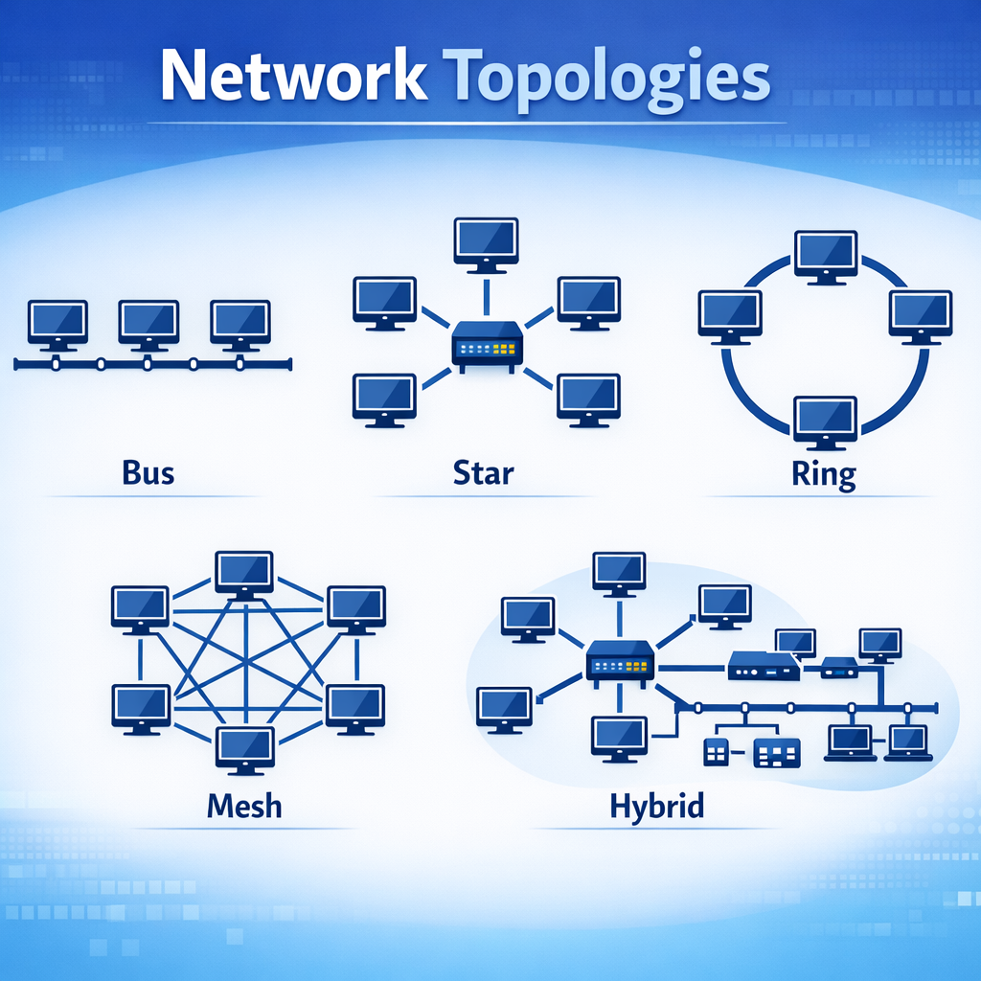
Network Topologies
Network Topologies
Definition: The physical or logical arrangement of nodes (devices) and connections in a network.

Slide 6
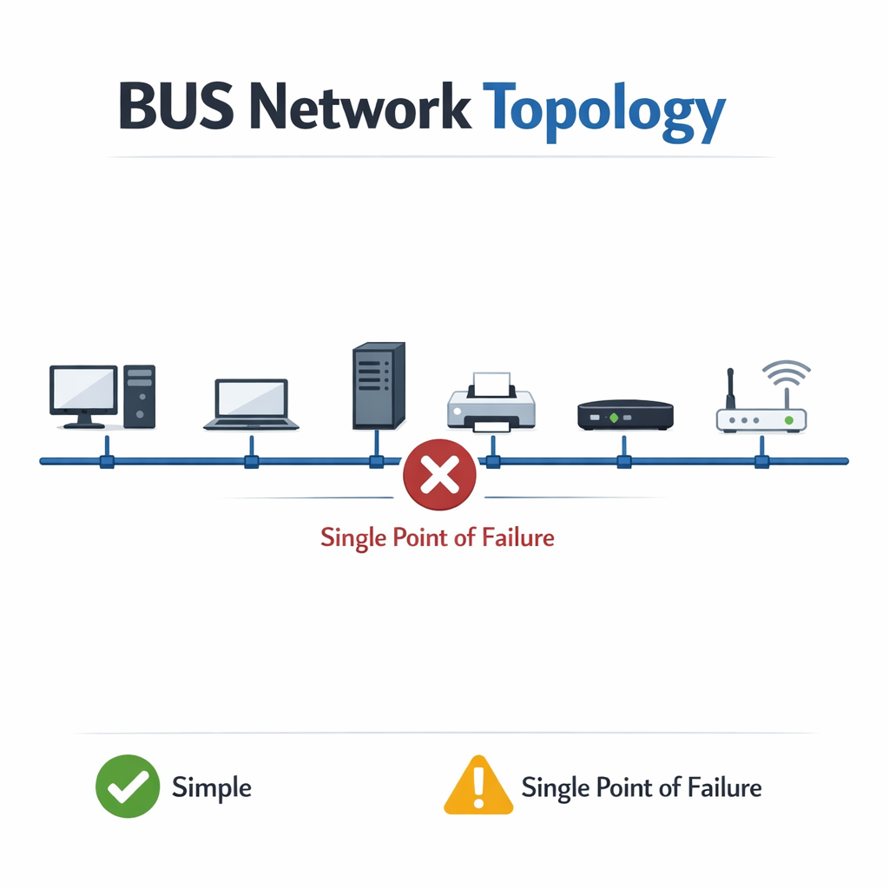
BUS Topology
Concept: All devices connected to a single cable (backbone).
Analogy: People on a single bus line.
Pros: Simple, less cable.
Cons: Single point of failure (backbone), difficult to troubleshoot, limited scalability.

Slide 7
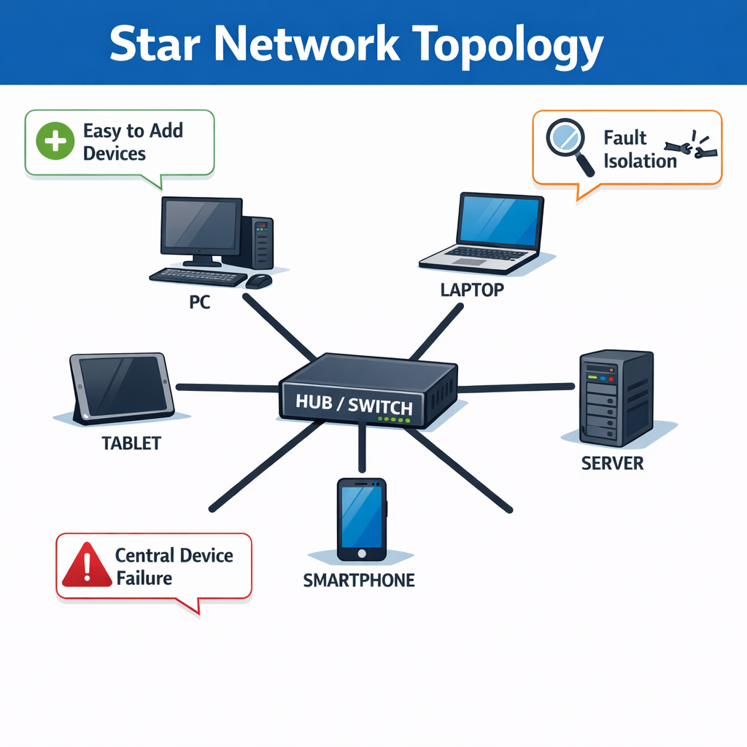
Star topology
Concept: All devices connect to a central hub/switch.
Analogy: Spokes of a bicycle wheel.
Pros: Easy to add/remove devices, fault isolation, common in modern LANs.
Cons: Central device failure impacts whole network segment, more cabling.

Slide 8
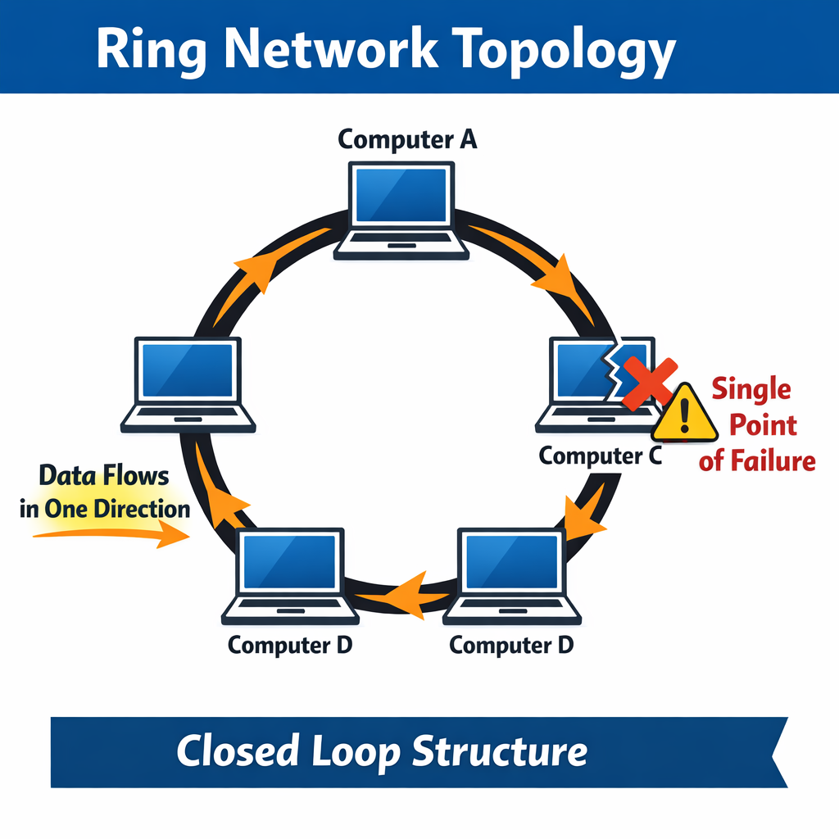
Ring topology
Concept: Devices connected in a closed loop. Data travels in one direction.
Pros: Predictable performance (in some implementations).
Cons: Single point of failure (if not dual ring), complex to troubleshoot.

Slide 9
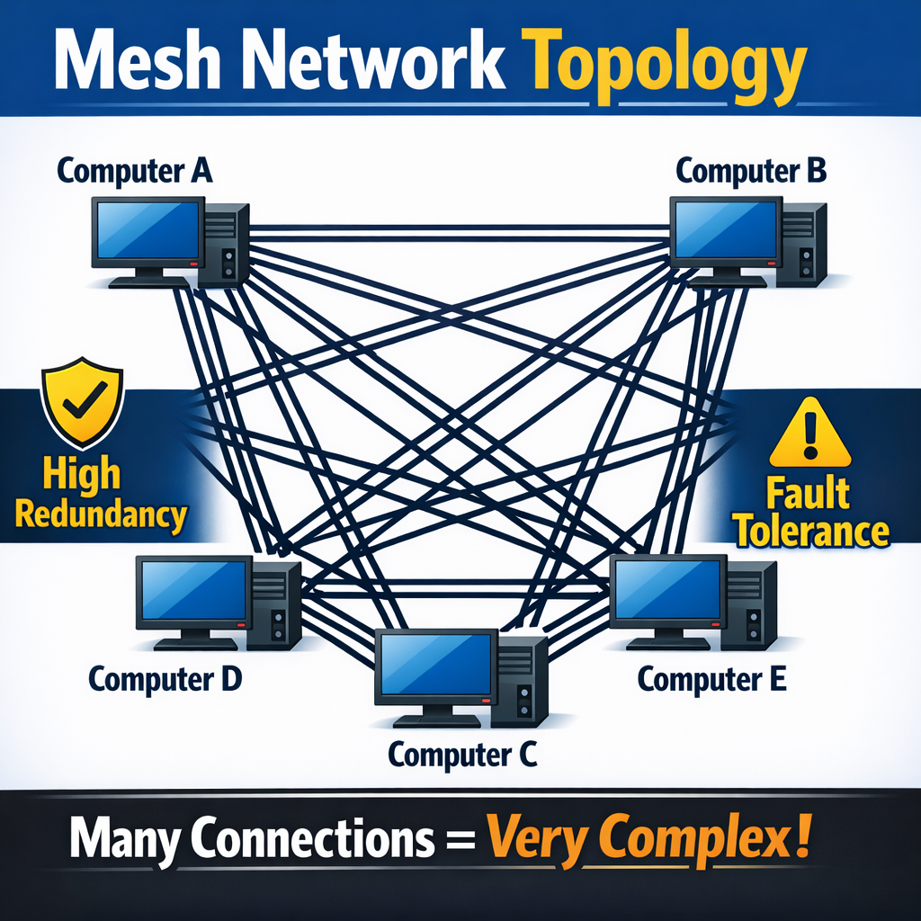
Mesh topology
Concept: Every device connected to every other device (full mesh) or some devices connected to others (partial mesh).
Pros: High redundancy, fault tolerance.
Cons: Very complex, expensive (full mesh), difficult to manage.

Slide 10
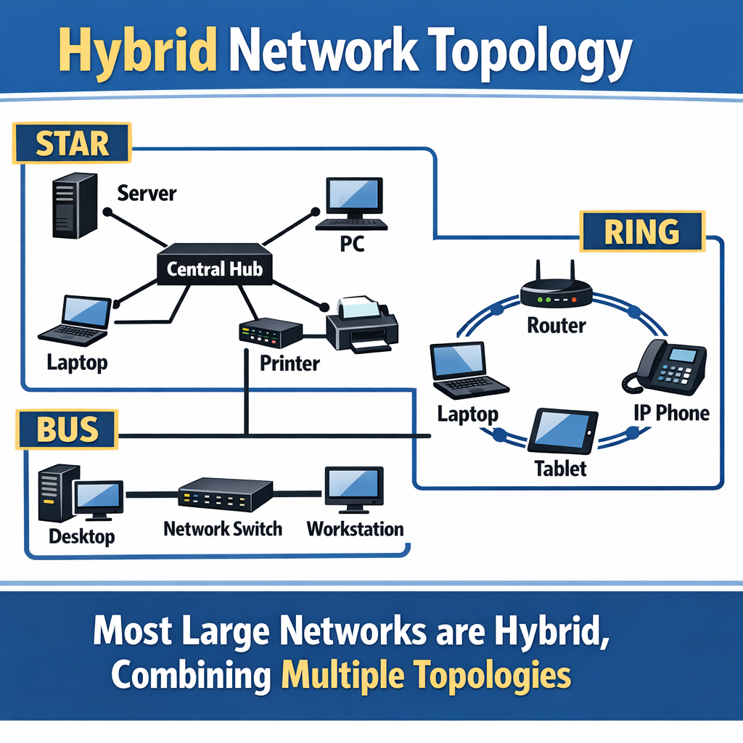
Hybrid topology
Concept: Combination of two or more topologies (e.g., star-bus).
Reality: Most large networks are hybrid.

Slide 11
Network Devices

Slide 12
NIC (Network Interface Card)
Purpose: Allows a device to connect to a network.
Function: Converts data into electrical signals for transmission.
Examples: Ethernet cards, Wi-Fi adapters.

Slide 13
Hub (layer 1- physical)
Purpose: Connects multiple devices in a star topology.
Function: Receives a signal and broadcasts it to all other connected ports.
Analogy: A simple splitter.
Downside: Creates collision domains, inefficient. (Less common today)

Slide 14
Switch (Layer 2 – Data Link)
Purpose: Connects multiple devices, more intelligent than a hub.
Function: Learns MAC addresses of connected devices and forwards traffic only to the destination port.
Analogy: A post office sorting mail.
Benefits: Reduces collisions, improves network performance.

Slide 15
Router (Layer 3 – Network)
Purpose: Connects different networks (e.g., LAN to WAN, different LANs).
Function: Forwards packets between networks based on IP addresses. Makes routing decisions.
Analogy: A traffic cop directing vehicles between cities.
Key Role: Interconnecting networks and the Internet.

Slide 16
Modem (Modulator-Demodulator)
Purpose: Converts digital signals from your computer into analog signals for transmission over a different medium (e.g., cable, fiber, DSL) and vice versa.
Essential for: Internet access.

Slide 17
Access Point (AP):
Purpose: Allows wireless devices to connect to a wired network.
Function: Converts wireless signals to wired Ethernet and vice versa.
Often combined with: Routers in home networks.

Slide 18
LAN (Local Area Network)
Scope: Small geographical area (e.g., home, office building, campus).
Characteristics: High speed, typically owned by one organization.
Examples: Your home Wi-Fi network, a school computer lab.

Slide 19
WAN (Wide Area Network)
Scope: Large geographical area (e.g., cities, countries, continents).
Characteristics: Connects multiple LANs, often uses public infrastructure (leased lines, Internet).
Examples: Connecting branch offices, the Internet itself.

Slide 20
WAN (Wide Area Network)
Scope: Large geographical area (e.g., cities, countries, continents).
Characteristics: Connects multiple LANs, often uses public infrastructure (leased lines, Internet).
Examples: Connecting branch offices, the Internet itself.

Slide 21
MAN (Metropolitan Area Network)
Scope: Covers a city or large campus.
Characteristics: Larger than a LAN, smaller than a WAN.
Often used by: Municipalities, large universities.

Slide 22
PAN (Personal Area Network):
Scope: Smallest network, within a person's reach.
Examples: Bluetooth headphones, connecting your phone to your laptop.

Slide 23
WLAN (Wireless Local Area Network):
Scope: A LAN that uses wireless communication.
Examples: Wi-Fi networks.

Slide 24
Networks-the logical

Slide 25
The OSI Model
Purpose: A conceptual framework for understanding how network communication works. Divides networking into 7 distinct layers.
Why is it important?
Standardization: Allows different vendors' devices to communicate.
Troubleshooting: Helps isolate problems to a specific layer.

Slide 26
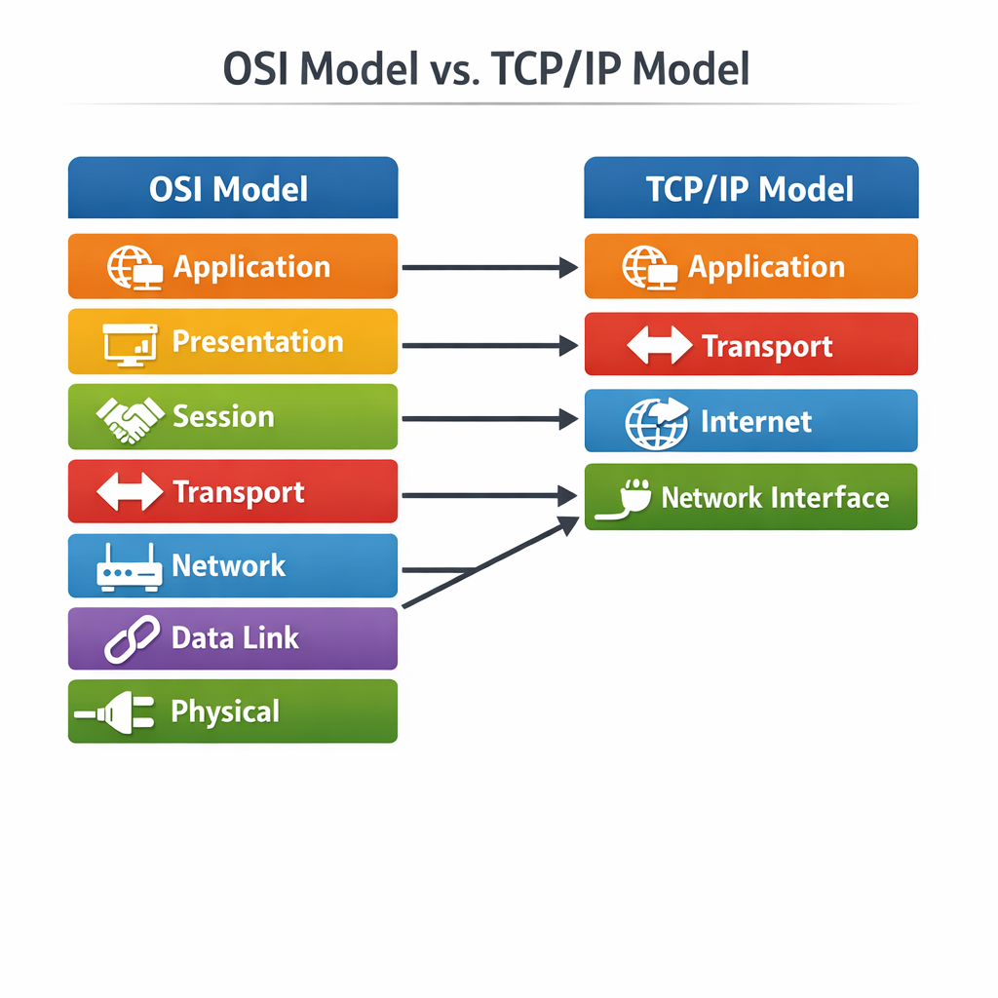
OSI Model vs TCP/IP Model

Slide 27
Exercise – OSI Model
Seven Groups
Present
What is a function/purpose of your assigned layer?
What is a relevant equipment or protocol for your assigned layer? Describe that equipment or protocol
Mnemonic: “All People Seem To Need Data Processing” (or come up with your own!)
Encapsulation/Decapsulation (briefly): How data is wrapped/unwrapped as it moves up/down the layers.

Slide 28
MAC Addressing (Physical Address)
Definition: A unique 48-bit (12 hexadecimal digits, e.g., 00:1A:2B:3C:4D:5E) hardware address "burned in" to a device's Network Interface Card (NIC).
Purpose: Identifies devices within the local network segment (LAN) for Layer 2 communication.
Key: First 6 hex digits (OUI) identify manufacturer; last 6 are unique to the device.

Slide 29
MAC Addressing (Physical Address)
MAC Addressing (Physical Address)
Role: Used by switches for local frame forwarding; doesn't traverse routers.
Relationship to IP: ARP maps Layer 3 IP addresses to Layer 2 MAC addresses on a local network.

Slide 30
IP Addressing (Logical Address)
Definition: A unique numerical label for devices using Internet Protocol, allowing identification and location on a network.
IPv4 (32-bit):
Dotted-decimal (e.g., 192.168.1.100).
Classes (A, B, C): General network size categories.
Private vs. Public: Private IPs (e.g., 192.168.x.x, 10.x.x.x) are for internal networks, non-routable on the Internet. Public IPs are globally unique and routable.

Slide 31
IP Addressing (Logical Address)
NAT: Translates private IPs to public IPs for Internet access.
Subnet Mask: Defines network vs. host portion of an IP, determining host count.
Default Gateway: Router IP for communicating with other networks.
IPv6 (128-bit): Hexadecimal (e.g., 2001:db8::1). Developed to address IPv4 exhaustion.

Slide 32
Key networking protocols

Slide 33
Key Networking Protocols (Group Exercise)
Find a buddy
Find the purpose of the assigned protocol, with its relevant port, and present:
ARP
SNMP
IRC
SSL
TLS
TELNET
SIP
BGP

Slide 34
Basic Network Security Concepts
Firewalls: Control network traffic based on security rules (like a network's security guard).
VPN (Virtual Private Network): Creates secure, encrypted connections over public networks for remote access/privacy.
Malware: Malicious software like viruses, worms, Trojans.
Social Engineering: Psychological manipulation (e.g., phishing).
Best Practices: Strong passwords, regular updates, physical security for devices.

Slide 35
DODIN Cloud Operations

Slide 36
DODIN Cloud Operations

Slide 37
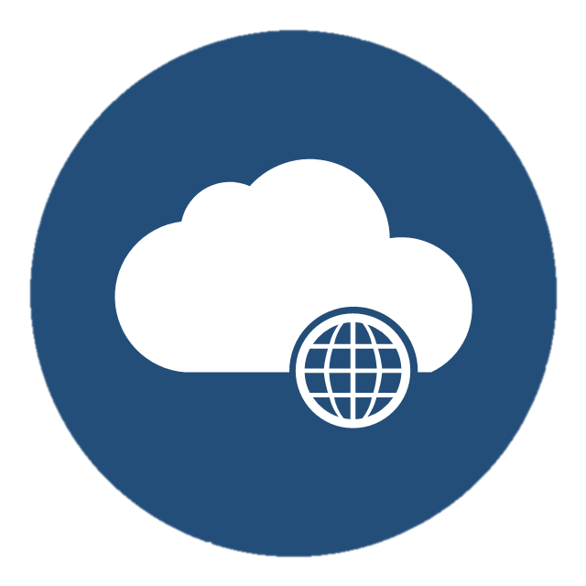



Networking (cont.)
Internet
COMMERCIAL(IL2) TRAFFIC INTO DODIN
IAP
Commercial CSP
DODIN
BCAP
GOVCLOUD CSP
Notes:
These slides will show in simple term how traffic flows from or to the DODIN via the internet, Commercial CSP, or GOVCLOUD.
Keep in mind every Agency (Army, Air Force, Navy, etc) have different security requirements and may have additional network protection and monitoring devices.
**
The first example is traffic from the DODIN to a Commercial CSP.
**
When a DODIN user types in a URL of a website, the DODIN internal Domain Name Server resolves that the website is hosted in a commercial Cloud Service Provider. It then routes the traffic out through the Internet Access Point or IAP. **
IAPs are the secure central connection point which is the barrier between the DoDIN and commercial Internet. The Defense Information Security Agency (DISA) inspects and manages all traffic inbound/outbound at the IAP, rules to ensure unsecure, unauthorized, or inappropriate internet connections are usually managed at the organizational level with web filtering and Firewall rules. DISA manages the final inbound/outbound traffic firewall rules at the IAP.
**
**
If allowed outbound through the IAP the traffic continues on via regular internet routing to its application/workload in the commercial CSP.
**
**
Inbound DoDIN traffic from non malicious users follows the same rules. It routes via commercial internet.
** **
It is inspected at the IAP and if deemed non-malicious allowed to access the DODIN resources.
This is how sites like organizations sharepoints are accessed from home computers.
** **
Malicious inbound traffic to the DODIN is inspected same as all other traffic at the IAP and will be stopped here when deemed unsafe or unauthorized.
DISA has internal SOP for dealing with this kind of traffic.
** ** **
However malicious traffic that tries to gain access to commercial workloads is completely left up to the Application security, that is not to say it is unsecure but DISA play no part in the security of this traffic.
ATO
ATC = ATO, SCCA, CSSP, IPs

Slide 38
Networking (cont.)
Internet
GOVCLOUD TRAFFIC INTO DODIN(BEFORE ATO)
IAP
Commercial CSP
DODIN
BCAP
GOVCLOUD CSP
Notes:
In this scenario we will take a quick look at traffic to GOVCLOUD. This example shows IL2 ATO’d traffic or IL4/5 traffic that has not yet been ATO’d and connected to the DODIN.
**
Much like traffic to commercial CSPs when a DODIN user tries to reach a GOVCLOUD application the traffic must go through the IAP and be inspected. **
Once through it travels through the commercial internet to reach GOVCLOUD CSPs.
While all GOVCLOUD CSPs have been FEDRAMPed approved as described before, the application is security is completely up to the Mission owner.
As part of the Cloud Shared Responsibility model, CSPs aren’t liable for network traffic allowed in by the Application/Workload owner.
And this reflects as well for valid and malicious user traffic coming from the internet as well.
All security is up to the application mission owner.

Slide 39
Networking (cont.)
Internet
GOVCLOUD TRAFFIC INTO DODIN(AFTER ATO)
IAP
Commercial CSP
DODIN
BCAP
*ATO SIGNED
*ATC APPROVED
*DISA IP’s
GOVCLOUD CSP
Connect to BCAP
Notes:
And our last example is how traffic that is IL4/5 ATO’d and has been connected to the DODIN.
**
Once all requirements of ATO have been signed as well as other DISA requirements, ** Cloud workload owners will connect to the Boundary Cloud Access Point or BCAP.
The purpose of the BCAP is to protect the DODIN by serving as a point defense to detect and prevent intrusion, unauthorized routes, known malicious code and malicious network activity.
A quick note, BCAPs are the currently the standard Cloud Access Point approved for Army use. Other Cloud Access Points do exist but they require a DoD CIO Exception to Policy.
Once connected to the BCAP the Commercial CSP workloads are given new IPS and become and extention of the DODIN.
This completely changes the routing of the cloud workloads, as this application or environment is no longer directly accessible from the general internet.
For internal DODIN traffic to GOVCLOUD Applications, users will not go out the IAP, they will instead go through the BCAP, be inspected and if authorized they will move on their application.
For external users to access these ATO’d environments they will now route via the internet to the IAP,
Thee IAP will block malicious and unauthorized users and authorized users and traffic will forwarded to the BCAP.
At the BCAP users will be inspected again and once through the users will have to go through the application security and identity to be authorized to access the data or service.
There are separate concepts such as Internal Cloud Access Points (ICAPs) which are required for on-prem cloud based solutions but are beyond the scope of this presentation.
This concludes the overview of the routing from DODIN to commercial or GOVCLOUD CSPs. Understanding these traffic flows can help ensure you are not breaking security authorizations by having higher impact levels of data on unauthorized networks.

